Slide 1

Swine Disease Risk Matrix
Eric Neumann (Epi-Insight USA LLC) and Bill Hall (BH and Associates)
Update, begin ranking, Q&A
8 September 2026

Slide 2
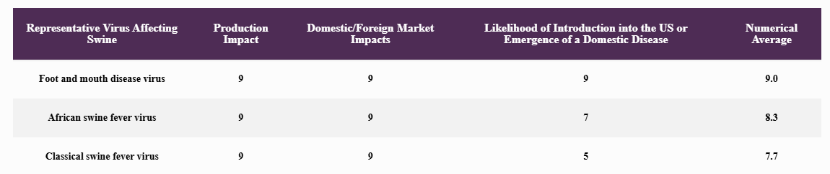
Viral disease matrix – current (2018)
The Working Group scored the risk using three criteria, each measured on a 1 (least) to 10 (most) scale.
Criterion 1: The likelihood of foreign pathogens entering the US and the likelihood of an endemic pathogen becoming recognized as the cause of an emerging disease or syndrome.
Criterion 2: The expected effects on production economics (morbidity, mortality, and production losses).
Criterion 3: Effect on domestic and/or international markets from an outbreak.
N = 46

Slide 3
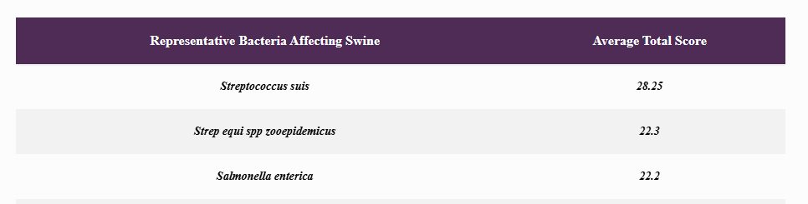
Bacterial disease matrix – current (2021)
The Working Group scored the risk using five criteria; method for summarizing not described (n = 46)
Criterion 1: Potential public health impact: (hazard x frequency)
  Zoonotic potential, transmissibility, antimicrobial resistance (AMR)
Criterion 2: Need for more efficacious intervention tools
  Biosecurity, vaccines, treatments
Criterion 3: Diagnostic tools
  Isolation capability, PCR, antibody detection
Criterion 4: Impact on pig health, welfare, production sustainability
Criterion 5: Market impact
  Domestic and foreign

Slide 4
Problems and Objectives
Problems
  Rely on subjective, non-transparent scoring
    No documented justification or uncertainty
    Do not explain how criteria or scores were derived (evidence?)
  Use equal weighting across criteria
    May not reflect stakeholder priorities.
Objectives
  Develop a harmonized, multi-criteria framework with transparent definitions
  Elicit stakeholder-weighted preferences
  Create evidence library for all agents
  Rank pathogens using standardized method
  Reproducible to allow future updating
    https://matrix.epi-insight.com/

Slide 5
MCDA: Multi-criteria decision analysis
Method 1: Today
Score and average
  3 to 5 criteria
    Likelihood of entry, production economics, market effects, etc
    Each scored 1 to 10 by the working group.
    The rank is the simple average.
  Criteria weighting come from nobody.
    Averaging is equal weighting.
Alternative 1: Simple
Weighted scorecard
  Same scores, but the committee states weights first
    E.g. entry 20%, production 50%, markets 30%
    Ranking is the weighted sum.
  Weights still suffer from bias, non-representative.
Alternative 2: Proposed
PAPRIKA
  Develop criteria.
    Define levels within criteria
  Inferred weighting
    Nobody states a weight.
    Answer “trade-off” questions and the weights are deduced
    Unbiased
  Weights are defendable, representative.

Slide 6

Methods
PAPRIKA method (Potentially All Pairwise Rankings of all Possible Alternatives)
  Pairwise comparisons between hypothetical pathogens that differ on only two criteria.
  For each pair, you select which pathogen has a higher priority.
  Through this series of simple trade-off decisions, the algorithm deduces the implicit weights you assign to each criterion.
    If A > B, and B > C, you already know A > C

Slide 7
Roadmap
Stage 1: Refinement of Pathogen List and Criteria
  Develop a full list of viral, bacterial, and parasitic agents (158 total) - DONE
  Develop criteria for prioritization – DONE
    Review by 8 external pig disease specialists - DONE
Stage 2: Targeted Literature Review and Data Curation
  Focus on evidence around each of the eight criteria
  Create process to update evidence when new information comes to light
Stage 3: Prioritization Exercise Using PAPRIKA
  SHIC Working Groups will complete online pairwise comparison exercises - NOW
Stage 4: Final Output
  A transparent, defensible ranked list of priority swine pathogens – 30 Sept 2026

Slide 8
PAPRIKA - example
  Matrix website (https://matrix.epi-insight.com/) – criteria cheatsheet
  People aren’t good at ranking, but…
    They are good at saying “I like this one better than that one” (i.e. pairwise comparisons)
  PAPRIKA
    Provides a method to incorporate “how strongly a person feels about their choice”
      Step 1: Are the CRITERIA (and levels within criteria) correct?
      Step 2: Literature review – find basic evidence around each criteria, for each disease - ESTABLISH FACTS.
      Step 3: Prioritization exercise – done by the stakeholders/committees, not by “the experts”. PRIORITIZE CRITERIA not DISEASES.
      Step 4: Analysis and reporting.
  Two-criteria demo
  1000minds survey Preview – Preview no longer working – survey is live!

Slide 9
Your role: the ranking exercise
You will be asked 40-70 questions.
  Two hypothetical diseases that differ on only two criteria: “Which has the higher research priority?”
There are no right answers. Your answers are the weights.
  No preparation — the questions are about hypothetical pathogens, not real ones.
  Please set aside an hour – needs to be done in one sitting – no cut-off, take as much time as needed.
  Everyone answers individually.
    Keep every person’s answers: measure disagreement, and look at whether producers, diagnosticians, regulators and industry weigh things differently.
Why so few questions?
  The eight criteria describe 36,864 possible pathogen profiles
  More than 640 million possible trade-offs
  Remember: If A > B, and B > C, you already know A > C

Slide 10
What comes back
A ranked list of 145 agents, with the weight each criterion carried.
  Plus, the disagreement, and — how much members differ, and whether that follows the kind of member.
13 agents that cannot be ranked, handled separately and openly.
  These each have at least one criterion with no evidence behind it
  Preview

Slide 11
The deliverable is the process, not the list
A ranked list goes out of date.
  A process that can be re-run does not.
Every level traces to a document.
  158 agents, each with an evidence folder
  Plain-language overview and a published brief
  Every ruling is attributed and dated.
It is already public (website: https://matrix.epi-insight.com/)
  All 158 briefs are live now.
  SHIC can host its own copy, behind a password if preferred.
Updating does not need you again.
  A new agent (or new evidence) is an evidence question, not a values question
    Assessment is updated > ranking re-runs against the existing criteria and weights
  You are only asked again if the CRITERIA or PRIORITIES change

Slide 12
Next steps
You will receive an email invitation from me (e.neumann@epi-insight.com)
  Link: Goes straight to your own set of questions in the browser.
  Nothing to install.
  Please complete it within a week.
  The analysis needs everybody in before it can report, so the last response sets the date. Expect to be chased.
Then we report back.
  The ranking, the weights, where members disagreed, and the separate treatment of the 13 agents the evidence cannot yet rank.
Questions?

